Slide 1



Review the Prototypes
Sustainable Use of AI
19 November, 2025

Slide 2

AGENDA
4Key Principles
Brainstorming Prototype Ideas
Shortlist of Concepts
Prototype A: Magic Mirror
Prototype B: Digital Forest Wall
Prototype C: Black Frame
Prototype D: Prompt Coach
Prototype E: GAIA Framework

Slide 3

4Key Principles
Building the solution
1
2
Respect User Intelligence
Make It Immediate
Provide information, not restrictions. Trust users to make good decisions when given clear data.
Show environmental cost before submission with visual, intuitive displays at the point of decision.
3
4
Seamless Integration
Celebrate Progress
Embed in existing tools. Browser extensions, not separate apps. Meet users where they work.
Track improvements, show wins. Positive framing instead of guilt. Make sustainability rewarding.

Slide 4

Brainstorming Prototype Ideas
We conducted a team ideation session to explore how we can make AI’s impact visible.
We generated over 30 ideas categorized under:
Awareness & Visualization
Behavior & Reflection
Playful Learning & Nudging

Slide 5




Shortlist of Concepts
Digital Forest Wall
Magic Mirror
Black Frame
pixel trees representing AI usage
A mirror that detects your face and shows your level of AI usage.
A white board/screen where a line is drawn on it after every use of AI.
Prompt Coach
GAIA framework
browser-based reflection tool
A white board/screen where a line is drawn on it after every use of AI.

Slide 6
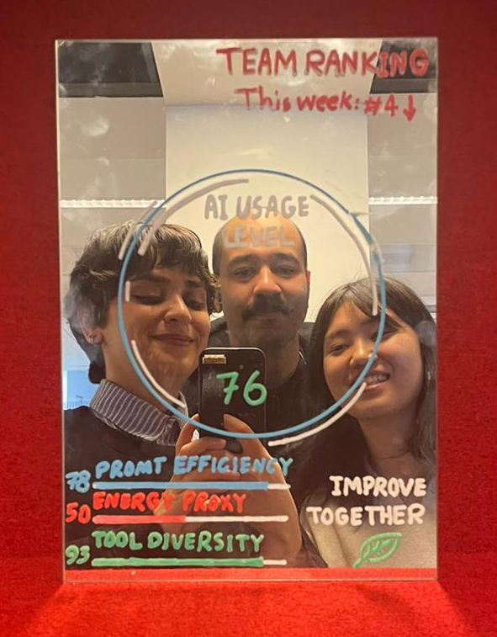
Prototype A: Magic Mirror
Smart mirror technology meets sustainability awareness.
01
02
Face Detection
Impact Display
Recognizes employees instantly
Shows collective environmental footprint
03
Actionable Tips
Provides personalized reduction strategies

Slide 7
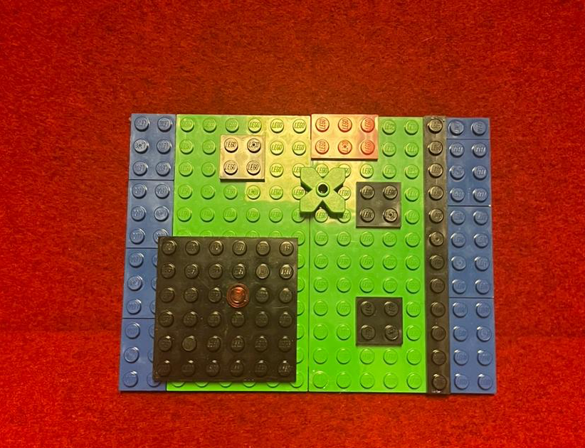
Prototype B: Digital Forest Wall
A large-screen installation displaying a digital forest. Employees' positive actions (like completing sustainability quizzes) cause new digital leaves to grow on a collective tree.

Slide 8


Prototype C: Black Frame
A physical whiteboard where employees manually mark each AI tool interaction.
One line per use
Creates visceral awareness of frequency
Collective visualization
Patterns emerge as community behavior becomes visible
Intentional friction
Manual tracking encourages thoughtful AI engagement

Slide 9
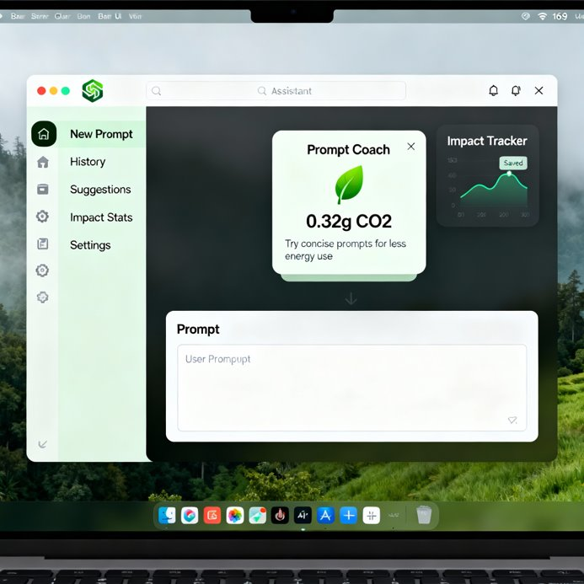
Prototype D: Prompt Coach
Precision prompting reduces computational waste.
Clarity Training
Learn to articulate exact requirements upfront
First-Try Success
Reduce iterations through better prompt engineering
Impact Reduction
Fewer computations mean lower environmental cost

Slide 10
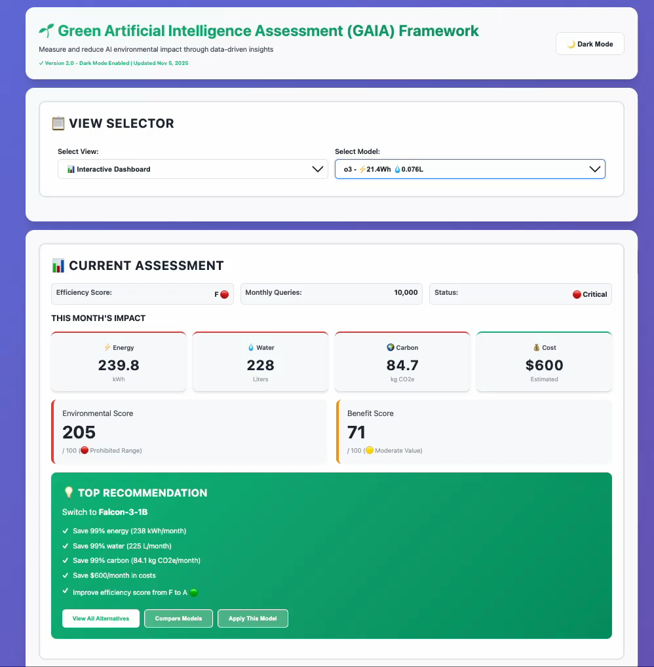




Prototype E: GAIA Framework
Comprehensive sustainability tracking and accountability system
Usage Analytics
Real-time monitoring of AI tool deployment across teams and projects
Impact Metrics
Quantify environmental footprint with transparent carbon calculations
Goal Setting
Establish reduction targets and track progress toward sustainability objectives
Team Engagement
Foster collective responsibility through shared visibility and achievements

Slide 11
Thank You.
19 November, 2025

